Slide 1
Motion Magic with CTRE Motor Controllers
ThunderChickens – FRC Team 217
CTRE Phoenix Motion Magic example
CTRE Phoenix motion profiling example

Slide 2
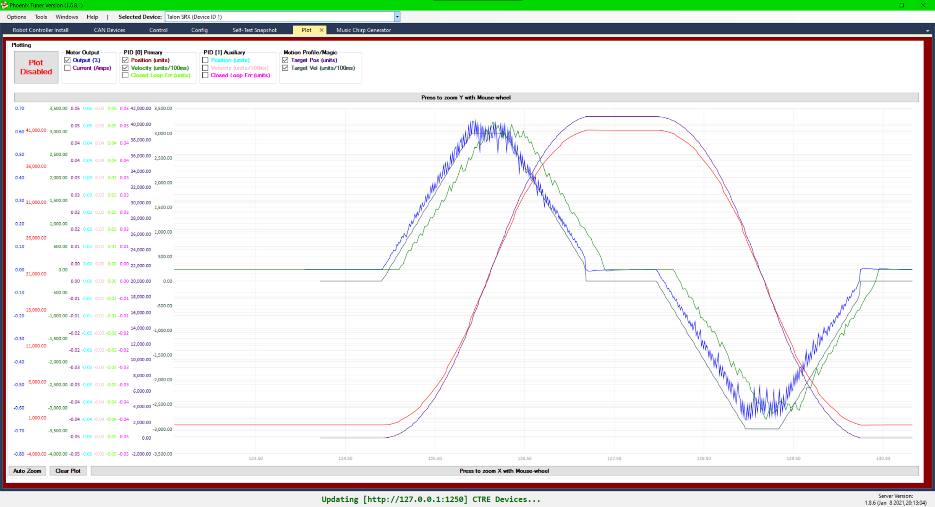
What is Motion Magic?
Drives the motor to a target position
A form of geometric motion profiling with PID
Feed forward on velocity target, PID on position target
Motion profile calculated as the motor runs

Slide 3
Advantages of Motion Magic
Simple to use
Pass in PID-F, cruise velocity, target acceleration, and S-curve smoothing (to round the corners of the trapezoidal profile) as configs
Pass in target position when running Motion Magic
Does not have to be calculated ahead of time
Position PID gives precise control of the behavior of the robot
Replaces position PID control
Has all the advantages of motion profiling with the simplicity of position PID control

Slide 4
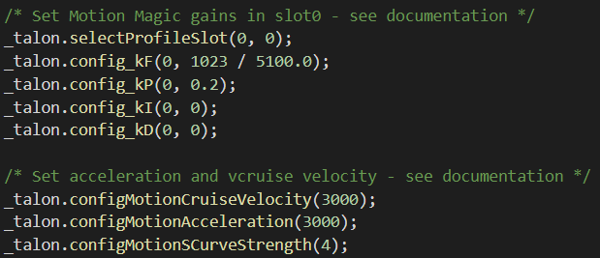

Configuring Motion Magic
Calculating kF:
Get motor velocity (with load) at a given percent output (Recommended: ~75% of max)
$kF=percOut∗\frac{1023}{motorVel}$
In the example below, the recorded velocity at 100% power was 5100 ticks/100ms

Slide 5
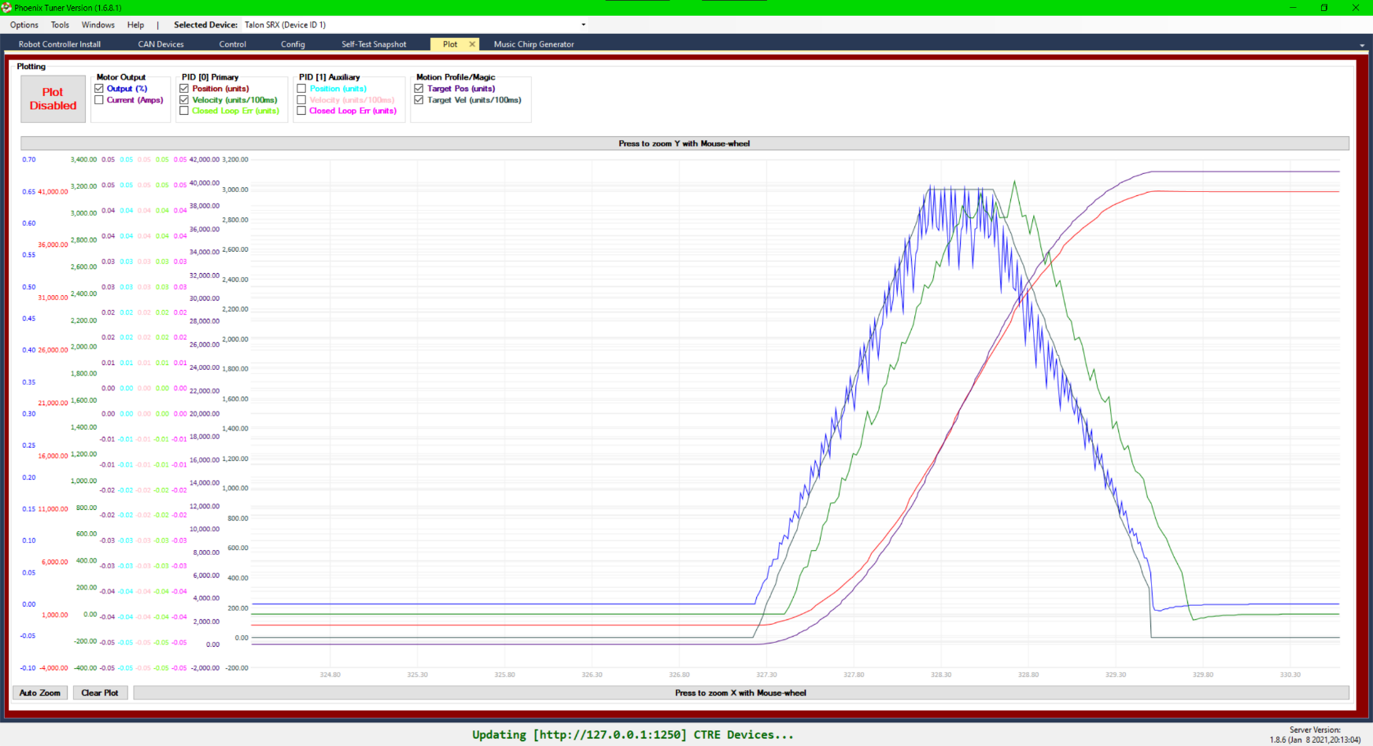
Running Motion Magic
Given the target position targetPos and Talon SRX/FX _talon:
_talon.set(ControlMode.MotionMagic, targetPos);
You can view percent output, current, target and recorded position and velocity, etc. in the Plot tab of Phoenix Tuner

Slide 6
What about Motion Profiling?
CTRE offers the ability to run a motion profile in a special motion profile control mode
Feed Forward (kF) applies to the profile target velocity
PID applies to the profile target position
Useful for passing in custom trajectories (such as from PathWeaver)
Requires a pre-calculated motion profile trajectory
Configuring PID-F is identical to Motion Magic

Slide 7

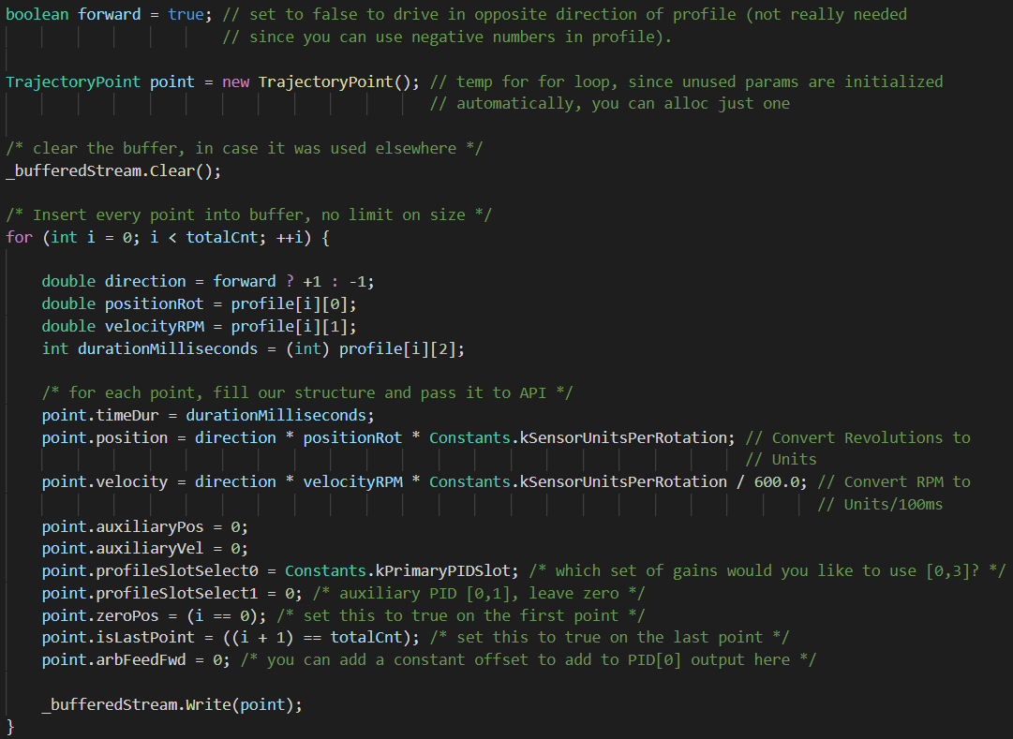

Using Motion Profiling
Configuring a motion profile
Configure PID-F (see Motion Magic)
Do not configure cruise velocity, acceleration, or S-curve strength
Add the points in the motion profile trajectory to a BufferedTrajectoryPointStream
Running a motion profile
Start the motion profile
Pass in the BufferedTrajectoryPointStream and the number of points to buffer
Run until the motion profile is finished:

Slide 8
When to Use Which
Motion Magic
Would normally use standard position PID control or a geometric motion profile
Want to have precise control of linear trajectories or of a single robot component (elevator, arm, etc.)
Motion Profiling
Want to accurately move along curved trajectories (drivebase)

